Slide 1
Before You Begin
Introduction to Unix for HPC

Slide 2
Agenda – Day 1 – Shell Primer
9:45 Welcome
10:00 – 11:15 Session 1 (Intro & Unit 1)
11:15 – 11:30 Short break
11:30 – 12:30 Session 2 (Unit 2+3)
12:30 – 1:30 Lunch
13:30– 14:45 Session 3 (Unit 4)
14:45 – 15:00 Short Break
15:00 – 16:15 Session 4 (Unit 5)

Slide 3
Agenda – Day 2 – Data & HPC
9:45 – 11:15 Session 1 (Data – Units 1+2+3)
11:15 – 11:30 Short break
11:30 – 12:30 Session 2 (Data – Units 4+5)
12:30 – 1:30 Lunch
13:30 – 15:30 Session 3 (HPC)

Slide 4
General Introduction
Intersect http://www.intersect.org.au/
Who we are?
Your Trainer
Your University IT Contacts
General Housekeeping
Toilets
Coffee & Water Facilities
Emergency Exits

Slide 5
Course Information
Who is the course intended for?
What will be covered during the 2 days?
More details in the course outline at http://www.intersect.org.au/course-resources
What level will you be at upon completion of the course?
Remember – It’s YOUR course, so ask questions!
Notes:
Who is this course for?
This is a two day general introductory course for researchers and PhD students who have never used high performance computing before or have had only limited exposure. It assumes only basic Windows competence (W.I.M.P.), and will teach participants how to interact via the command line, move data between different locations and prepare and run it through the HPC facilities. It will be delivered in a small group workshop including presentations and hands-on exercises with tutors.
Shell competence
• how to connect to the Intersect HPC facility by connecting/establishing a session in a command line environment using a Linux shell
• the basics of using Putty and Secure Shell (SSH) to log in to the HPC machine
• the basics of how a shell works (commands, arguments)
• how to navigate and create a directory hierarchy using Bourne Again Shell (BASH) commands
• how to inspect and summarise the contents of files using BASH commands
• how to save the output of commands, and how to link commands together
Data Handling for HPC usage
• how to transfer data to and from the HPC machine.
• how to perform in-situ editing of files on the HPC machine
• how to change permissions on files and folders on the HPC machine for individual users and groups
• how to install and configure an FTP program
• how to navigate around local and remote folders.
• how to transfer files between local and remote folders.
• different file types: text, binary, DOS, Unix.
• using Putty Secure Copy (PSCP) for bulk transfers on the command line.
• how to get a dataset off the web and onto the server.
Using the HPC to run jobs
• manage jobs on the HPC machine using Portable Batch System (PBS)
• understand the disk partitions, properties and when to use them
• write job scripts
• submit and delete jobs
• understand some PBS environment variables
• understand machine limits

Slide 6
Download training materials
Training Material available from:
http://www.intersect.org.au/course-resources
Download the Slides and Exercises and save to a local directory, e.g. C:\HPC:
Course Outlines: Shell Primer, Data, HPC
Slides: Shell Primer, Data, HPC Slides
Exercises

Slide 7
Install software
Use your web browser to download Putty and PuttySCP from: http://www.putty.org
Click on the “Download Putty” link and download:
putty.exe (a Telnet and SSH client)
pscp.exe (an SCP client, i.e. command-line secure file copy)
Double click to install on your PC.
Notes:
Explain about SSH & Telnet, and explain what the Putty client is used for

Slide 8
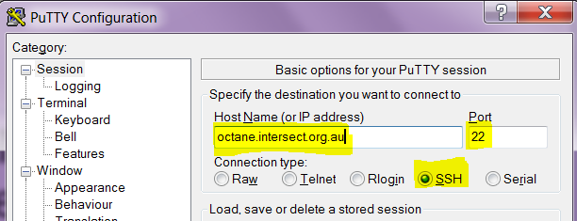
Logging On
Start the putty telnet/ssh client by double clicking on putty.exe and connect to the HPC Machine
Host: octane.intersect.org.au
Connection Type: ssh
Port: 22
Notes:
[Instructions to the instructor are in brackets and bold]
Users may be presented with a security warning for the first time they connect from their machine (accept ssh key). They should click OK to accept.

Slide 9
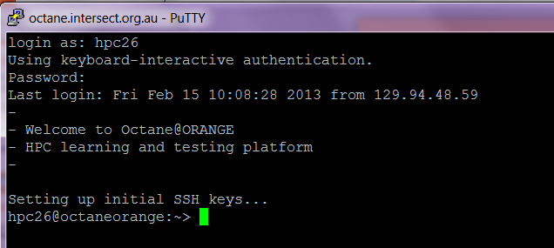
Log On to the HPC Machine
Log into the training HPC system using the Test Account allocated to you, e.g.
Account Name: hpc26
Password: train26
Notes:
[Instructions to the instructor are in brackets and bold]

Slide 10
Shell Primer
Introduction to Unix for HPC

Slide 11
Unit 1: Run Spot, Run
Goals:
Can run commands, including when there are spaces in arguments
Can use ‘man’ to find out more about commands, including arguments and parameters

Slide 12
UNIX Operating System
UNIX was initially developed by AT&T employees at Bell Labs in 1969
Common Variants today: Linux, OpenSolaris, FreeBSD, HP/UX, AIX
100’s of Major Linux Distributions: Debian-based (e.g. Ubuntu), Red Hat Package Manager (RPM)-based (SUSE, Red Hat & Fedora)
Octane uses SUSE LINUX

Slide 13
What is a Shell?
The shell is a command line interpreter or shell that provides an interface to the UNIX operating system.
A shell has a single purpose – to allow users to enter commands to execute, or create scripts containing commands, to direct the operation of the computer
Notes:
A computer runs programs/commands. That’s what it’s for.
A shell is a program that allows users to ask the computer to run other programs.
On a windows system, the philosophy is that commands are big things, and you run them once to do your work. They are easy to use, but not very flexible.
On a Linux/Unix system, the philosophy is that commands are small things that do one small thing. They are hard to use, but very flexible.
BASH is the shell that we use, and is more or less the de-facto standard shell for Linux.
Everything you do on the HPC system involves either telling a shell to run commands, or getting ready to tell a shell to run commands.
When you first log in to an HPC system, you will be presented with the command prompt.
You have already run commands before – for example when you installed this module.

Slide 14
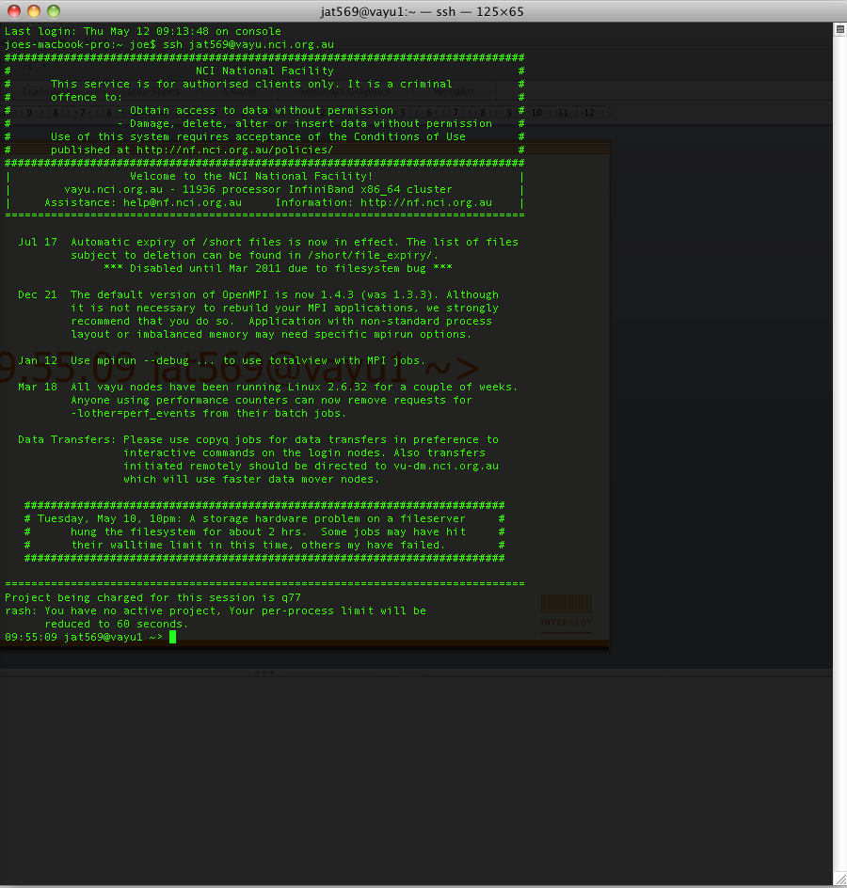
Notes:
This is a picture of what shells look like for me.
[Point out]
the shell runs inside a window called a ‘terminal’
the shell has a prompt that is waiting for your input
The prompt can vary – I use it to keep track of where I am (more on this later)

Slide 15
More on UNIX Shells
This course uses BASH
BASH = the Bourne-Again Shell
Default shell for most Linux systems
Other common Shells include:
C Shell (csh)
K Shell (ksh)
TENEX C Shell (tcsh)

Slide 16
What does BASH do?
The shell (command line interpreter) interprets the commands entered by the user and passes those to the UNIX operating system.
When enter a command and hit return
BASH parses the command line into tokens
1st token is interpreted as the command
Remaining tokens are interpreted as arguments

Slide 17
Anatomy of a command
Commands comprise of:
a command that invokes a program
arguments to that program
hpc85@octaneorange:~> cmd arg1 arg2 arg3
hpc85@octaneorange:~> cmd arg1 arg2 arg3 “arg 4”
command prompt
command
Arguments (3)
command
Arguments (4)
Notes:
Each time you enter something on the command line and hit return, BASH will do something.
Almost every time, it will run the command specified by the first word on the command line, and pass it the arguments specified by the rest of the words on the command line.
Discuss use of white space in arguments

Slide 18
Commands and Shells
Commands allow users to interact with the operating system via the shell
Two-way communication is possible between the shell and commands
e.g. the ls command will return a list of files in a directory

Slide 19

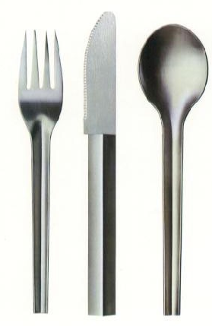
Notes:
Explain the difference between using a program (e.g. powerpoint) which has a huge set of commands in-built
versus
Running individual commands which all together can be very powerful

Slide 20
Exercise 1(a) Running Commands
Command | Description
ls | Shows a directory listing
w | Shows who is logged on to the system and what they are doing
w hpc22 | Shows login, idle time, and what user hpc22 is doing
finger | Shows login, username & login details of users on the system
finger hpc22 | Shows user hpc22’s login details including name, idle time, login time as well as some of their environment settings
date | Prints the system time and date
uptime | Tells you how long the system has been running

Slide 21
Command Line Options (Flags)
Command Line Options / Flags modify the operation of the command.
There are two forms of flags – Short Form & Long Form.
Flags are case sensitive!
Short form options start with a single hyphen “-”
rm –f <filename> → force removal of file
Long form Options start with a double hyphen “--”
rm –-force <filename> → force removal of file
Both commands do the exact same thing!

Slide 22
Sample Command & Flags
ls –a
short form flag “-a”
Shows all files incl. files starting with .
ls –-all
long form flag “--all”
Shows all files incl. files starting with .
Notes:
There are also conventions – the community of Linux developers got together and said “let’s do it like this.” Like all conventions, there are plenty to choose from.

Slide 23
More Commands & Flags
ls –l
short form flag “-l”
Shows the long format listing for all files in the directory
Notes:
There are also conventions – the community of Linux developers got together and said “let’s do it like this.” Like all conventions, there are plenty to choose from.

Slide 24
Combining Flags
Flags can be combined in any order but still mean the same thing
The following command and flags all show the directory contents and show one file per line:
ls –a -l
ls –l -a
ls –la
ls –al
ls –-all –l
ls –l -all

Slide 25
Command Line Arguments
Command Line Parameters are arguments sent to the program being called.
There are two forms of parameters – Short Form & Long Form.
Parameters are case sensitive!
Short form options start with a single hyphen “-”
tail –n 20 <filename> → tail from the last 20 lines of the file
Long form Options start with a double hyphen “--”
tail –-lines=20 <filename> → tail from the last 20 lines of the file

Slide 26
Exercise 1(b) Flags and Parameters
Command | Description
ls | Shows a directory listing
ls -l | (long) Lists directory contents of current directory using long listing format
ls –a ls --all | (all) Lists directory contents of current directory and does not ignore entries starting with .
ls –la ls –all –a | (all+long) Lists directory contents of current directory using long listing format and does not ignore entries starting with .
ls –format=horizontal | Lists directory contents of current directory horizontally
ls -–format=single-column | Lists directory contents of current directory in a single column

Slide 27
Using the “man” pages
All Unix systems come equipped with manual or “man” pages which contain documentation about how each in-built command works
Man pages can be accessed using the following command format:
man program, e.g. man ls

Slide 28
The online manual
man is a command that takes as its argument the name of another command.
NAME
find - search for files in a directory hierarchy
SYNOPSIS
find [-H] [-L] [-P] [path...] [expression]
The [] indicate an optional argument (you don’t type these)
Notes:
[These are important for the exercises.]

Slide 29
Exercise 1(c) The Calendar
Command | Description
man <command name> | Print the online manual entry for <command name>
cal | Print a calendar

Slide 30
Unit 2: Where am I?
Goals:
Can explore navigate a hierarchy of directories
Can specify files with relative and absolute paths
Can create a hierarchy of directories
Can copy and move files between directories

Slide 31
UNIX Directories
Called ‘folders’ under windows
Exactly the same concept
You run into them a LOT more under Unix than you do under windows
A directory is a container
It can contain files and other directories
Notes:
The concept of a working directory is there in every program, but you often don’t realise it under windows.
Directories are the de-facto way of managing and organising data in Linux. Making your HPC life easy will in a large part depend on keeping files and directories clean. Many of you have already learned this lesson on windows. This module is intended to give you to tools to do the same thing.

Slide 32
/
ac3
What are the names of the contents of the directory called “/” (root folder)?
bin
etc
home
usr
/ac3
/bin
/etc
/home
/usr
Notes:
A directory is a container for files and other directories. There’s lots of ways to visualise it, but a common one is as a tree view. Another is as a graph of boxes, with arrows representing directories. And yet another is as stacked boxes one within another.
One of the things that a directory can contain is other directories.
[Introduce the notation – closed and open directories.]
Question 1: What is the contents of the directory called “/”
Answer: ac3, bin, etc, home, usr
[Here is where we bring up absolute and relative paths.]
[Make note of case sensitivity.]

Slide 33
/
ac3
What are the names of the contents of the directory called /home?
bin
etc
home
hpc01
/home/hpc01
/home/hpc02
/home/hpc03
/home/hpc21
hpc02
hpc03
hpc21
usr
Notes:
Opening the home directory, we can see the contents (there will be more in real life).
[Introduce the notion of a PATH.]

Slide 34
/
ac3
What are the names of the contents of the directory called /home/hpc02?
bin
etc
home
hpc01
/home/hpc02/regurgitator.sh
hpc02
regurgitator.sh
hpc03
hpc21
What are the names of the contents of the directory called /home/hpc21?
regurgitator.sh
usr
/home/hpc21/regurgitator.sh
Notes:
You can also put files into a directory.
Every file on your computer has a unique name (it starts with a /, and tells you exactly where the file lives).
Note that files can have the same name, as long as they are in different directories.

Slide 35
/
ac3
bin
etc
home
hpc01
hpc02
regurgitator.sh
hpc03
hpc21
regurgitator.sh
usr
Path separator
/home/hpc02/regurgitator.sh
Where do I start from?
Path components
Notes:
[Anatomy of a path]

Slide 36
Rules So Far
There is one root, called “/”
This is different from windows, where there is one root for each disk drive C:, D:, etc
A path from the root designates exactly one file: such a path is called an “absolute path”
Notes:
[Make note of C: D: vs just /….]

Slide 37
The Home Directory
Each account (user) has a special directory called his/her home directory
That’s where you ‘get put’ when you log in. (More on this later)
BASH uses the “~” character to indicate “home directory”
Two forms
~ “my home directory”
~hpc01 “hpc01’s home directory”

Slide 38
/
ac3
What are the names of the contents of the directory called ~
bin
etc
It depends who asks: If the user “hpc02” asks, then the answer is
/home/hpc02/regurgitator.sh
home
hpc01
hpc02
regurgitator.sh
hpc03
What are the names of the contents of the directory called ~hpc21
hpc21
regurgitator.sh
usr
/home/hpc21/regurgitator.sh
What is the absolute path of the file ~hpc02/regurgitator.sh
/home/hpc02/regurgitator.sh
Notes:
You can also put files into a directory.
Every file on your computer has a unique name (it starts with a /, and tells you exactly where the file lives).
Note that files can have the same name, as long as they are in different directories.

Slide 39
/
ac3
bin
etc
home
hpc01
hpc02
regurgitator.sh
hpc03
hpc21
regurgitator.sh
usr
Path separator
~hpc02/regurgitator.sh
Path components
Where do I start?
Notes:
Also works for just a ~, but you have to know which user is running the command.

Slide 40
Rules So Far
There is one root, called “/”
A path starting with “/” means “from the root”
A path starting with “~” means “from the home”

Slide 41
Exercise 2(a) Finding your way around
Command | Description
cd | Change the working directory to your home directory
cd <path> | Change directory to <path>
ls | List the contents of the working directory
ls <path> | List the contents of <path>

Slide 42
The Working Directory
BASH maintains a “working” or “current” directory. That is “the directory that you are currently in”
Your prompt will show you your current working directory
Linux uses the “.” character to denote the working directory. You can use this when running commands
ls –la . → show the listing for the current dir
The command “pwd” will list the current working directory
Notes:
Make note of C: D: vs just /….

Slide 43
~
What is the absolute path of “step one/file one”
experiments
experiment one
description
What is the working directory?
step one
file one
file two
step two
file one
experiment two
description
step one
file one
file two
step two
file one
Notes:
[Keep asking the question and click three times.]
- what is the answer to “what is inside ‘file one’?”
- it depends on the answer to “what directory am I in?”
[Here is where we bring up absolute and relative paths.]
[Make note of case sensitivity.]

Slide 44
Looking upwards
UNIX uses “..” to denote the parent of a directory. You can use this when running commands, e.g.
cd .. → change up 1 directory
cd ../hpc01 → change up 1 directory, then down 1 directory to hpc01
UNIX understands “..” as a “normal directory” and it can appear in a path

Slide 45
~
What is the absolute path of
../experiment two/step one/file one
experiments
experiment one
description
What is the working directory?
step one
file one
file two
step two
file one
experiment two
description
step one
file one
file two
step two
file one
Notes:
[Keep asking the question and click three times.]
- what is the answer to “what is inside ‘file one?”
- it depends on the answer to “what directory am I in?”
[Here is where we bring up absolute and relative paths.]
[Make note of case sensitivity. ]

Slide 46
~
experiments
experiment one
description
step one
file one
file two
step two
file one
experiment two
description
step one
Path separator
file one
file two
step two
file one
../experiment two/step one/file one
Where do I start?
Path components
Notes:
[Keep asking the question and click three times.]
- what is the answer to “what is inside ‘file one’?”
- it depends on the answer to “what directory am I in?”
[Here is where we bring up absolute and relative paths.]
[Make note of case sensitivity. ]

Slide 47
Everything about directories
There is one root, called “/”
A path starting with “/” means “from the root”
A path starting with “~” means “from the home”
A path starting with anything else means “from the working directory”
Note – the last and second last rules assume a hidden context (current user and current directory)

Slide 48
Exercise 2(b) Finding your way around
Command | Description
pwd | Print the name of the current working directory
cd .. | Change directory to the parent directory
ls | List the contents of the working directory
ls . | List the contents of the working directory
ls .. | List the contents of the parent directory

Slide 49
Making New Directories
You can create a directory, but only one at a time (by default)
mkdir </path/new_directory>
mkdir </path/to/new/directory>
Notes:
The path/to/new/directory has a very special property: path, path/to and path/to/new all have to exist, but path/to/new/directory must not exist.
[***JOE: FIX THIS***]

Slide 50
What happens when you execute the commands?
~
experiments
experiment one
mkdir ~/experiments
cd ~/experiments
mkdir “experiment one”
mkdir “experiment one/step one”
mkdir “experiment one/step two”
mkdir “experiment two”
cd “experiment two”
mkdir “step one”
mkdir “step two”
step one
step two
experiment two
step one
step two

Slide 51
Exercise 2(c) Making Directories
Command | Description
mkdir <path> | Make a directory at <path>
pwd | Print the name of the current working directory
cd <path> | Change directory to <path>
ls <path> | List the contents of <path>
~
experiments
experiment one
step one
step two
experiment two
step one
step two

Slide 52
Moving/Copying Files Around
Files live in exactly one location
Files can be copied and moved between directories
cp <from path/file> <to path/file>
mv <from path/file> <to path/file>

Slide 53
~
What happens when you execute the commands?
experiments
experiment one
description
step one
cp “experiment one/description” “experiment two”
file one
cd “experiment one”
file two
step two
cp “step one/file one” “../experiment two/step two”
file one
cp “../experiment two/description” ../other
experiment two
cd “../experiment two/step one”
description
step one
mv “file one” “../step two”
file one
file two
step two
file one
other

Slide 54
Exercise 2(d) Moving and Copying Files
Command | Description
cp <from> <to> | Copy a file from <from> to <to>
mv <from> <to> | Copy a file from <from> to <to> then remove <from>
man cp man mv | Print the online manual entry for <command name>. What happens when you provide more than two arguments to cp and mv?

Slide 55
Unit 3: It’s what’s inside that counts
Goals:
Can look inside files (even really big ones)
Can obtain rudimentary information about files

Slide 56
What’s in a file?
my dame has a lame tame crane
my dame has a crane that is lame
pray, gentle jane, that my dame's lame tame crane
feed and come home again
0000000: 011011010111100100100000011001000110000101101101 my dam
0000006: 011001010010000001101000011000010111001100100000 e has
000000c: 011000010010000001101100011000010110110101100101 a lame
0000012: 001000000111010001100001011011010110010100100000 tame
0000018: 011000110111001001100001011011100110010100001010 crane.
000001e: 011011010111100100100000011001000110000101101101 my dam
0000024: 011001010010000001101000011000010111001100100000 e has
000002a: 011000010010000001100011011100100110000101101110 a cran
0000030: 011001010010000001110100011010000110000101110100 e that
0000036: 001000000110100101110011001000000110110001100001 is la
000003c: 011011010110010100001010011100000111001001100001 me.pra
Notes:
This is a dump from a text file containing the above poem…
It’s all just 0’s and 1’s.

Slide 57
What’s in a file?
This power-point presentation.
0000000: 010100000100101100000011000001000001010000000000 PK....
0000006: 000001100000000000001000000000000000000000000000 ......
000000c: 001000010000000011010111110011110010000111101110 !...!.
0000012: 001000100000001100000000000000000000010100011110 ".....
0000018: 000000000000000000010011000000000000100000000010 ......
000001e: 010110110100001101101111011011100111010001100101 [Conte
0000024: 011011100111010001011111010101000111100101110000 nt_Typ
000002a: 011001010111001101011101001011100111100001101101 es].xm
0000030: 011011000010000010100010000001000000001000101000 l ...(
0000036: 101000000000000000000010000000000000000000000000 ......
000003c: 000000000000000000000000000000000000000000000000 ......

Slide 58
What is a ‘text file’?
109
104
10
0000000: 011011010111100100100000011001000110000101101101 my dam
0000006: 011001010010000001101000011000010111001100100000 e has
000000c: 011000010010000001101100011000010110110101100101 a lame
0000012: 001000000111010001100001011011010110010100100000 tame
0000018: 011000110111001001100001011011100110010100001010 crane.
000001e: 011011010111100100100000011001000110000101101101 my dam
0000024: 011001010010000001101000011000010111001100100000 e has
000002a: 011000010010000001100011011100100110000101101110 a cran
0000030: 011001010010000001110100011010000110000101110100 e that
0000036: 001000000110100101110011001000000110110001100001 is la
000003c: 011011010110010100001010011100000111001001100001 me.pra
Notes:
A bunch of people get together and say
“Let’s define a mapping from 0’s and 1’s to a way to display them”

Slide 59
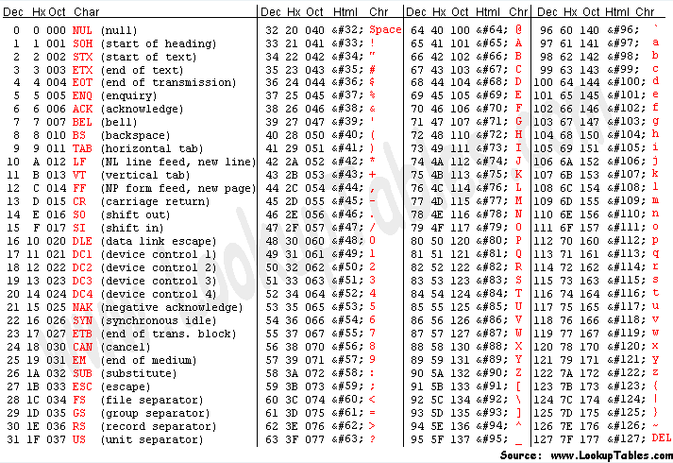
Notes:
[Probably worth noting that only 7 bits are used here.]

Slide 60
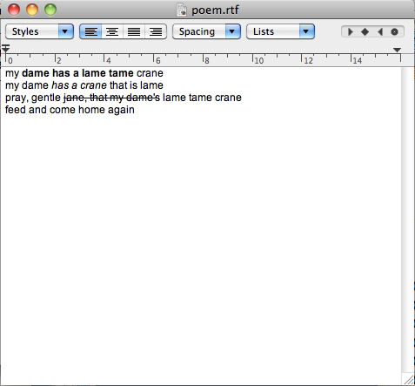
Two sides of the same coin
{\rtf1\ansi\ansicpg1252\cocoartf1038\cocoasubrtf350
{\fonttbl\f0\fswiss\fcharset0 ArialMT;}
{\colortbl;\red255\green255\blue255;}
\paperw11900\paperh16840\margl1440\margr1440\vieww9000\viewh8400\viewkind0
\deftab720
\pard\pardeftab720\ql\qnatural
\f0\fs24 \cf0 my
\b dame has a lame tame
\b0 crane\
my dame
\i has a crane
\i0 that is lame\
pray, gentle \strike \strikec0 jane, that my dame's\strike0\striked0 lame tame crane\
feed and come home again\
}
Notes:
There are two levels of encoding here. An editor that supports RTF can make sense of these. Because it is a text format, people can (maybe) understand it too. Ha!

Slide 61
Why do we care?
BASH is more or less committed to ASCII text
In particular
your keystrokes result in ASCII codes being sent to the shell
when a program generates output, it is interpreted by the shell as ASCII codes and displayed on the screen (even some non-printables)
Notes:
We’re going to focus on text files, since more or less binary files are just moved about on Linux, or have custom apps to deal with them.
BUT: remember that when someone says “Text File”, they may or may not mean the same thing as you. (Never mind, in HPC, it means ASCII tables and LF as the line feed).

Slide 62
Exercise 3(a) Looking into files
Command | Description
ls | You’ve met before
cat <filename> | Print a file to the terminal (catenate)
less <filename> | Like cat, but less at a time
head <filename> | Like cat, but just the top of the file
tail <filename> | Like cat, but just the end of the file
wc <filename> | Word count – count the words in a file
du | Disk usage – how much space is used

Slide 63
Unit 4: It’s all just files
Goals:
Can save the output of programs into files
Can chain commands together
Notes:
[Make note about the philosophy again – smaller number of concepts – this time console and keyboard are just files. Flexible, but confusing.]

Slide 64
The core magic of the Linux command line
The next bit is the core magic of Linux, as far as this module goes.
The keyboard is just a file
The console is just a file
Define – What is input?
Define – What is output?

Slide 65
OUTPUT
The program
INPUT
ERRORS
Notes:
Can write to other places if it wants to, but every Linux program has access to STDIN, STDOUT and STDERR

Slide 66

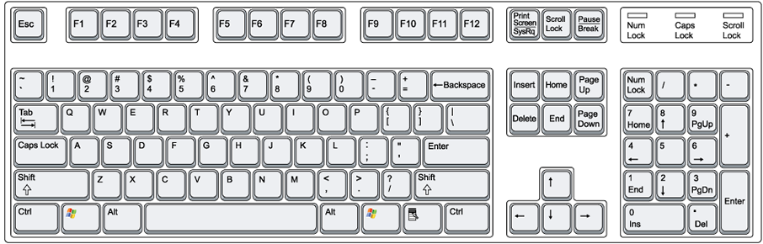
OUTPUT
The program
INPUT
ERRORS
command

Slide 67

Redirect OUTPUT elsewhere…
>
OUTPUT
The program
INPUT
ERRORS
command > filename

Slide 68
Append OUTPUT elsewhere…
>>
OUTPUT
The program
INPUT
ERRORS
command >> filename
Notes:
Won’t overwrite the file, but rather append.
[Mention < as well.]

Slide 69
Pipe OUTPUT to a command…
|
Another program
OUTPUT
INPUT
The program
OUTPUT
INPUT
ERRORS
ERRORS
command | another_command
Notes:
This is the glue that allows lots of little programs to work together.

Slide 70
Exercise 4(a) Looking into files
Command | Description
fortune | Tells your fortune – really! Try it!
sort <file> | Sorts the contents of <file>, or input if no file is specified.
uniq <file> | Removes any redundant lines in <file>, or input if no file is specified. Redundant lines have to be adjacent to be considered redundant.
cat <file> | Prints the contents of <file>
<command> > <file> | Run <command> but rather than print the output to the console, redirect the output to <file>.
<command> >> <file> | Run <command> but rather than print the output to the console, append the output to <file>.
<command> | <command> | Pipe one <command> to another <command>

Slide 71
Unit 5: Products of our environment
Goals:
Can set and read environment variables
Can add programs to the PATH
Can query the environment for which variables exist

Slide 72
Case study – finding programs
Recall from previous units
Sometimes you have to specify the path of a program
regurgitator.sh
./regurgitator.sh
../regurgitator.sh
/bin/regurgitator.sh
Notes:
So, how does the shell work out what program you are using?
What is the difference between all of these invocations – especially the first two?
The answer is that the first one will inspect the path!

Slide 73
PATH
There is a ‘special’ thing called the PATH
Part of what makes it special is encoded
Part of what makes it special is convention
There is an environment full of variables
One of those variables is called PATH
Use ‘$’ to tell BASH you’re talking about a variable
To check what an environment variable is set to, use $<ENVIRONMENT_VARIABLE>
e.g. $PATH
Notes:
The encoded aspect in there are variables, and the operating system will manage them for you.
The convention part is that one of the variables is called PATH, and that is where most things (e.g. shells like BASH) will look for programs to run.

Slide 74
A sample path
/bin:/usr/bin:/usr/local/bin:.
Notes:
Search order. First one found wins.

Slide 75
What does BASH do?
When you hit return
BASH parses the command line into tokens
Any ‘special’ tokens are expanded
The first token is treated as the command
The remaining tokens are passed to the command as arguments
Notes:
[Recall from very early in the module.]

Slide 76
A simple example
Your home directory is stored in the environment, you can be taken there directly
cd $HOME

Slide 77
Exercise 5(a) Realistic Evaluation of the Environment
Command | Description
$<VARIABLE> | Evaluates to the contents of the variable <VARIABLE>.
env | Prints all environment variables and their values.
echo <arg1> <arg2> … | Prints out its arguments, with no additional information.
grep <pattern> <file> | Prints out all occurrences of <pattern> in <file>. If no file is specified, processes standard input. For example env | grep PA will print all variables containing ‘PA’ in them or their value.

Slide 78
Manipulating the Environment
You can use the environment to your advantage.
Update the path
Change your prompt
Use the environment to share information between your scripts

Slide 79
The export command
The export command is used to set the value of an environment variable:
export <VARIABLE_NAME>=<VALUE>
Notes:
[Bring special attention to where the $ sign is used, typically.]

Slide 80
Exercise 5(b) Manipulating the Environment
Command | Description
export <VAR>=<VAL> | Set a variable called VAR and give it contents VAL. The variable will be available to programs invoked from the shell.

Slide 81
Summing up – Your Skills
You have now got the rudimentary skills to move around, make and view files, chain commands together and manipulate the environment

Slide 82
Summing up – Hard Lessons
BASH is wildly picky
Silent success
Command-line work is flexible but error prone
There’s a lot of hidden context
ENVIRONMENT, WORKING DIRECTORY, STDOUT/STDIN, COMMAND LINE EXPANSION
BASH is wildly picky

Slide 83
Summing up – the positives
Command line gives you a more powerful means to control a program
Allows direct interaction with shell commands (no GUI needed)
Allow for ease of automation via scripting
UNIX is more flexible and can be installed on many different types of machines (e.g. mainframes/supercomputers)
Unix possesses much greater processing power than Windows.

